Slide 1
Calculations – Variable Declarations
Lesson #7

Slide 2

‘expr’ Command

Slide 3

“expr” command
Bourne, ‘C’ and Korn shells
Syntax:
  expr <value> operation <value>
  Operators:
    Addition [ + ] and Subtraction [ - ]
    Multiplication [ \* ] and Division [ / ]
    Remainder [ % ]

Slide 4
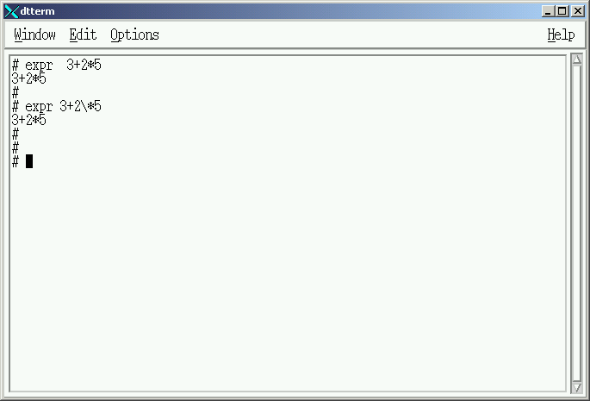

Syntax Requirement
Spaces Required

Slide 5
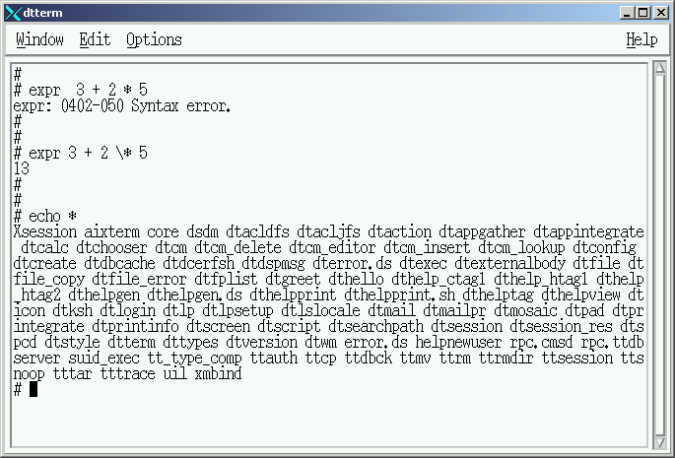
Multiplication Syntax
Multiplication Operation
Backslash Required

Slide 6
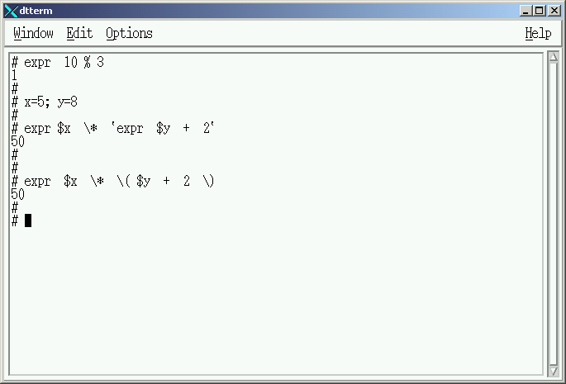
Calculating Remainer
10 Divided by 3 = 3 with 1 remaining

Slide 7

Variable Initialization
X=5
Y=8

Slide 8
Multiple Commands
Y= 8 + 2 (10)
X=5 * 10 (50)
Multiple Expressions NOT allowed

Slide 9
Korn Shell Expressions
Y= 8 + 2 (10)
X=5 * 10 (50)

Slide 10
“let” Command

Slide 11
“let” command
Korn and ‘C’ shells
Ten times faster than ‘expr’ command
Multiple Base Support (Default = 10)
Multiple expressions on same line
Double quoted ‘tabs’ & ‘spaces’ required

Slide 12

“let” command
Syntax:
  let <value>operation<value>
  let “<value> operation <value>”
  (( <value> operation <value> ))
  Operators:
    Addition [ + ] and Subtraction [ - ]
    Multiplication [ * ] and Division [ / ]
    Remainder [ % ]

Slide 13
“let” command
Syntax:
  let <value>operation<value>
  let “<value> operation <value>”
  (( <value> operation <value> ))
  Operators:
    Addition [ + ] and Subtraction [ - ]
    Multiplication [ * ] and Division [ / ]
    Remainder [ % ]

Slide 14
“let” command
Syntax:
  let <value>operation<value>
  let “<value> operation <value>”
  (( <value> operation <value> ))
  Operators:
    Addition [ + ] and Subtraction [ - ]
    Multiplication [ * ] and Division [ / ]
    Remainder [ % ]

Slide 15
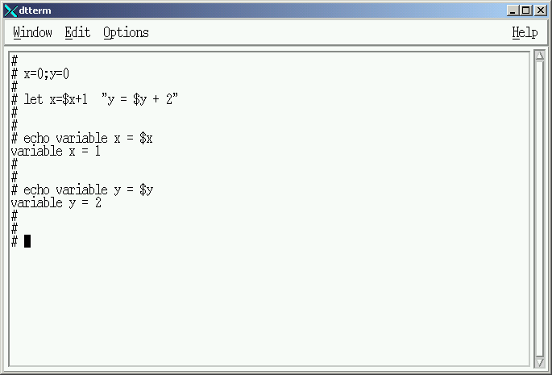

Variable Initialization

Slide 16
Multiple Expressions
No Spaces Allowed

Slide 17
Multiple Expressions
X=1
Y=2
Spaces Requires Double Quotes around expression

Slide 18
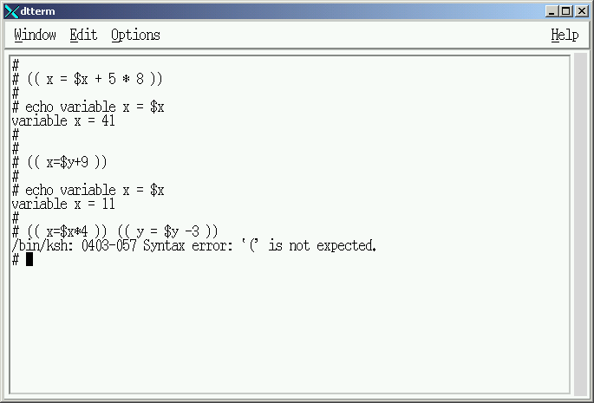

Korn Shell syntax
X=1
5 * 8 = 40
Y=2
X = 1 + 40 (41)

Slide 19
Korn Shell syntax
X = 41
Y=2
X = 2 + 9 (11)

Slide 20
Korn Shell syntax
Multiple Expressions NOT allowed

Slide 21
‘typeset’ Command

Slide 22
“typeset” command
Variable Options
  Declaring Interger variables
  Fixed Length variables
  Left or Right Justified variables
  Automatic Character Conversion
  Automatic Integer Base Conversion
  etc

Slide 23
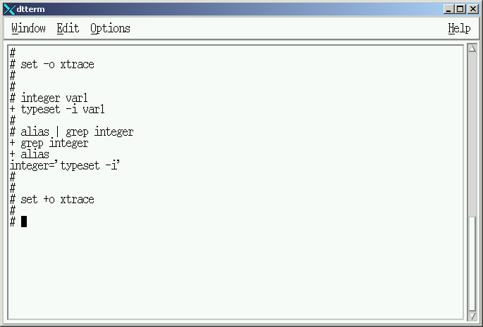
“integer” Alias “typeset”

Slide 24
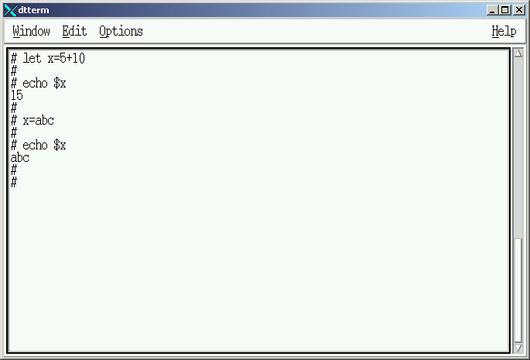
Default variable Declaration
Variable “x”
15
Alpha/Numeric
Variable “x”
abc
Alpha/Numeric

Slide 25
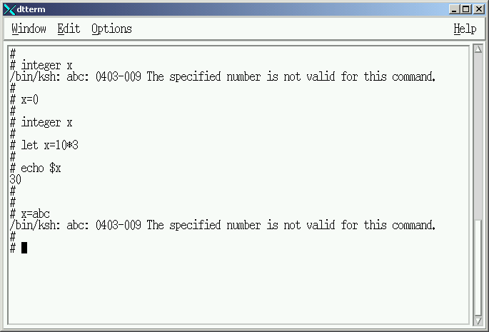

Integer variable Declaration
Variable “x”
abc
ERROR: Variable content violates declaration
Alpha/Numeric

Slide 26
Integer variable Declaration
Variable “x”
30
Integer

Slide 27
Integer variable Declaration
Variable “x”
30
Integer
ERROR: Data Type violates declaration

Slide 28
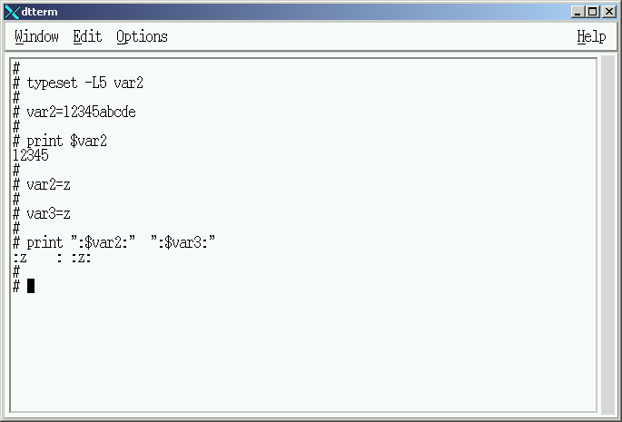
Length / Left Justification Declaration
Variable “var2”
?????
Alpha/Numberic
Alpha/Numberic
Length = 5
Left Justified

Slide 29
Length / Left Justification Declaration
Variable “var2”
12345
Alpha/Numberic
Alpha/Numberic
Length = 5
Left Justified

Slide 30
Length / Left Justification Declaration
Variable “var2”
Variable “var3”
“z “
z
Alpha/Numberic
Alpha/Numberic
Length = 5
Left Justified

Slide 31
Length / Left Justification Declaration
Variable “var2”
Variable “var2”
Variable “var3”
“z “
z
Alpha/Numberic
Alpha/Numberic
Length = 5
Length = unlimited

Slide 32
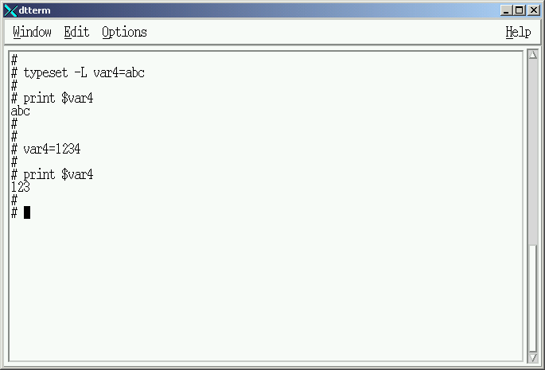
Initialization / Length Declaration
Variable “var4”
abc
Alpha/Numberic
Length = 3

Slide 33
Initialization / Length Declaration
Variable “var4”
123
Alpha/Numberic
Length = 3

Slide 34
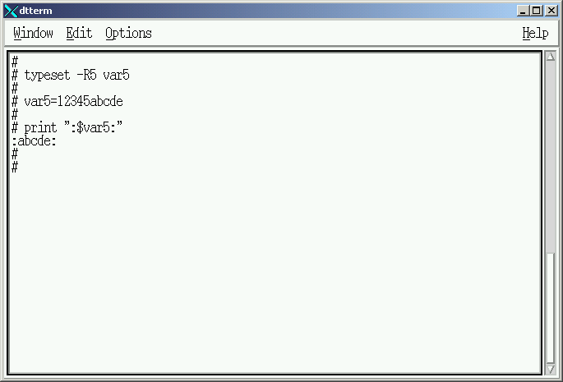
Length / Right Justification Declaration
Variable “var5”
?????
Alpha/Numberic
Length = 5
Right Justified

Slide 35
Length / Right Justification Declaration
Variable “var5”
abcde
Alpha/Numberic
Length = 5
Right Justified

Slide 36
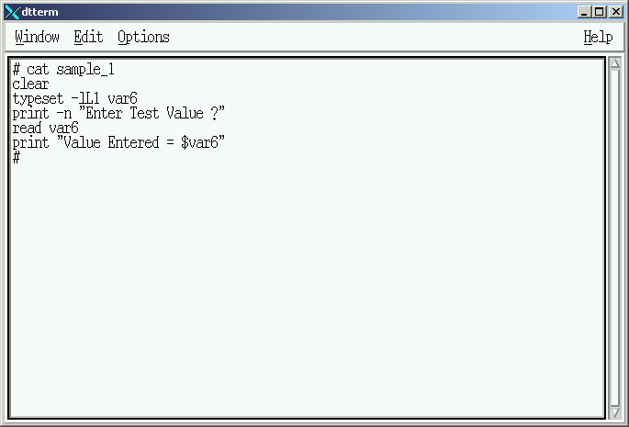
Multiple Declarations
Variable “var6”
“-l ” lower case translation
“L” Left Justified
“1” Length = 1

Slide 37
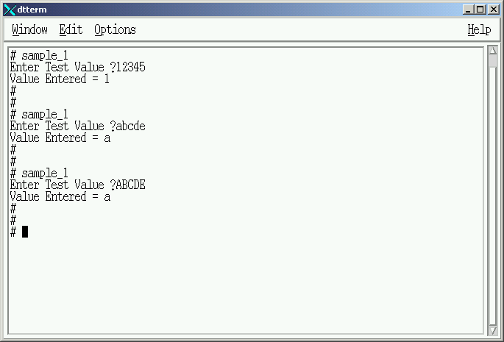
Example
Variable “var6”
1
Alpha/Numberic
Length = 1
Left Justified
Translation

Slide 38
Example
Variable “var6”
a
Alpha/Numberic
Length = 1
Left Justified
Translation

Slide 39
Example
Variable “var6”
a
Alpha/Numberic
Length = 1
Left Justified
Translation

Slide 40
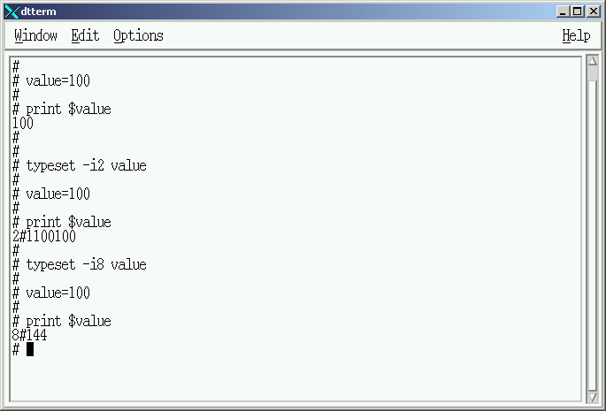
Interger Base Declaration
Default Base Value = 10 (decimal)

Slide 41
Interger Base Declaration
Base 2 - Binary

Slide 42
Interger Base Declaration
Base 8 -Octal

Slide 43
‘typeset’ documentation

Slide 44
‘typeset’ - Documentation
Browser URL:
http://publib.boulder.ibm.com/doc_link/en_US/a_doc_lib/ aixuser/usrosdev/korn_builtin_cmds.htm#A265913ea

Slide 45
‘typeset’ - Notice
Certain combinations of “typeset” options cannot be declared on the same variable. Resolution:
  Define a variable with one declaration
  ( ie: typeset -xx var1 )
  Enter data into the variable under control of the first declaration
  ( ie: read var1 )

Slide 46
‘typeset’ - Notice
Resolution:
  Assign another ‘typeset’ declaration to another variable and copy the value of the first variable into the newly defined variable.
  ( ie: typeset -xx var2=$var1 )
  ‘typeset’ will evaluate the data placed in the new variable based on the new declaration.

Slide 47
Lab #5

Slide 48
Lab 5 – General Instructions
Headings documentation requirements:
  Name
  Course
  Lab
  Date
Document command usage on first instance only

Slide 49
Lab 5 – General Instructions
Shellscripts MUST be completed ontime
Assigned Due Date:
  Run shellscripts for instructor
  Turn-in hardcopy of all shellscripts

Slide 50
Lab 5A – Calculator script
Prompt the operator to select an operation:
  “+” for addition “*” for multiplication
  “-” for subtraction “/” for division
  Restrict selection to a single character
Redisplay the prompt if any other character is entered

Slide 51
Lab 5A – Calculator script
Prompt the operator for a number to be used in the calculation.
  Restrict the number to two characters
  Restrict the number to Integer type
If a non-integer is entered the script should start over. Hint: Start this script as a child of a control script which will test return code of failed ‘typeset’ declarations.

Slide 52
Lab 5A – Calculator script
Prompt the operator for a second number to be used in the calculation.
  Restrict the number to two characters
  Restrict the number to Integer type
If a non-integer is entered the script should start over. Hint: Start this script as a child of a control script which will test return code of failed ‘typeset’ declarations.

Slide 53
Lab 5A – Calculator script
Perform a calculation using:
  Selected operation
  Two Integer numbers
Display the following:
  First Number
  Operation
  Second Number
  Calculation Result

Slide 54
Lab 5A – Calculator script
Hold the information on the screen until the operator depresses the ‘enter’ key.

Slide 55
Lab 5B – Conversion script
Prompt the operator to select a number base to convert to:
  “2” for Binary
  “8” for Octal
  “16” for Hexadecimal
Restrict response to TWO characters
If any other value is entered redisplay the selection and prompt again.

Slide 56
Lab 5B – Conversion script
Clear the screen and prompt the operator for a decimal number to convert.
  Convert the decimal number to desired base
  Convert all Alphanumeric characters to upper case
  Strip away all characters resulting from the conversion that describe the converted value
  (ie: 2#100101 should be 100101 )

Slide 57
Lab 5B – Conversion script
Display the following:
  Desired Number Base
  Original Decimal Value
  Converted Value
Hold the information on the screen until the operator depresses the ‘enter’ key.

Slide 58
Lab 5 – Menu Integration
Modify Lab4 Menu to identify Labs 4 and 5 are executed from a sub-menu.
Labs 5A and 5B must be integrated into the sub-menu created in Lab 4.
  Replacing the “Future Lab” place holders
  Execute Labs 5A and 5B from the Menu
  Return to the Menu after each script terminates

Slide 59
Calculations – Variable Declarations
Lesson #7 - Completed

